Slide 1
Tasks 2E & 2F: Scenario Evaluation & Economic Analysis
Goal was to bring together the first stages of this analysis and identify the most cost-efficient mix of technologies for future supply of heating.
The analysis determines the overall Net Present Value including CAPEX, OPEX, residual value, and the social cost of carbon over a 20-year period.
The social cost of carbon, or CO2e emissions, is referenced in NYSDEC guidance
The Levelized Cost of Energy (LCOE) is then calculated for each option to identify the consumer’s lowest cost solution and compare different resource types

Slide 2
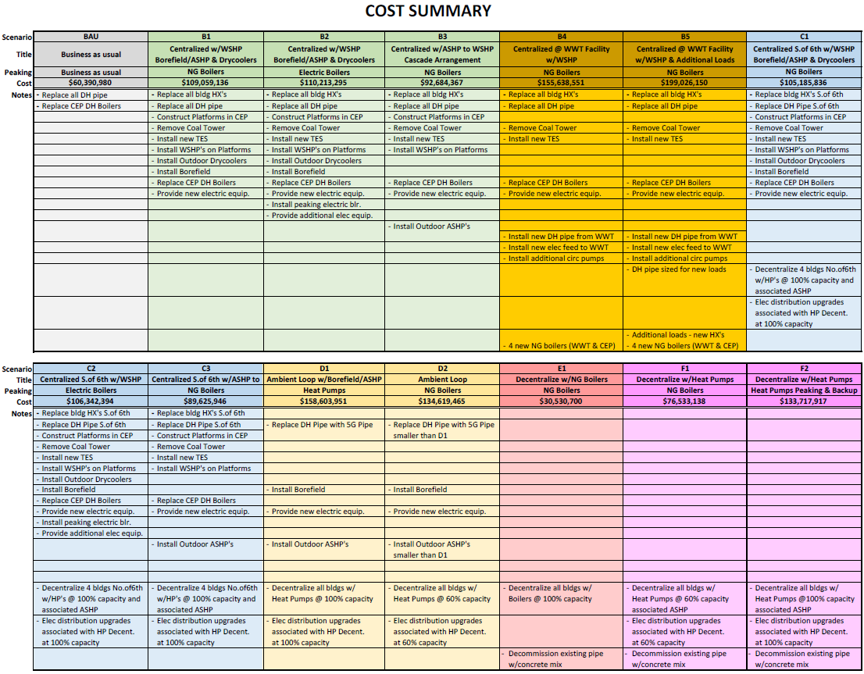
Notes:
Illustrates capital cost and work included for each option

Slide 3
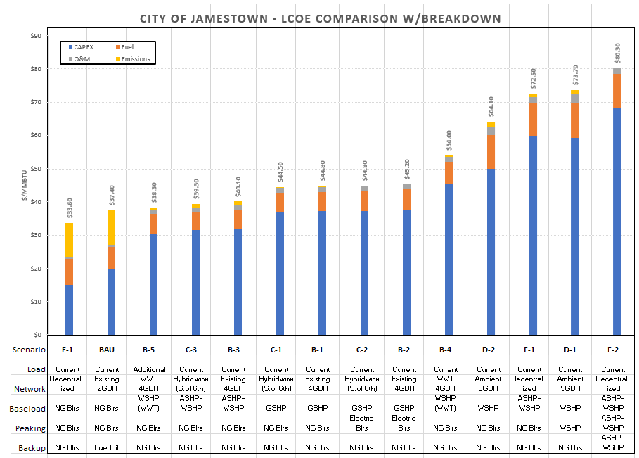
Notes:
Shows the effective, “all in” energy price for each system. Not this does not include staffing

Slide 4
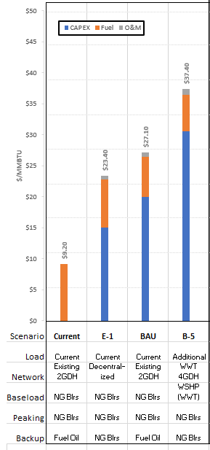
LCOE with out costs of emissions
Notes:
Illustrates the price with out the cost of carbon (since there is no mechninsims that causes customers to have to pay that cost today) which shows that distributed natural gas boilers are still the cheaper with the closest decarbonization option (B-5) almost 1.6x more expensive. It also illustrates that the current rates customers are paying are clearly unsustainable and that no matter what option is progressed, customers can expect to see a significant increase in heating costs.

Slide 5
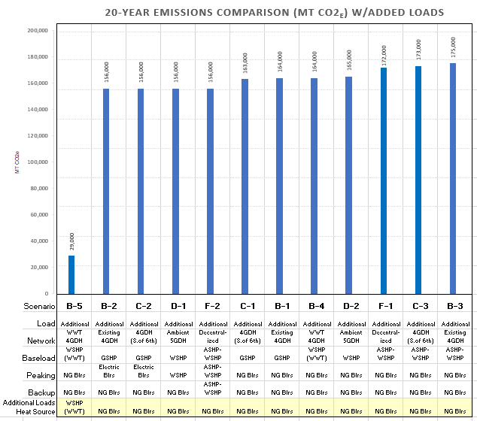
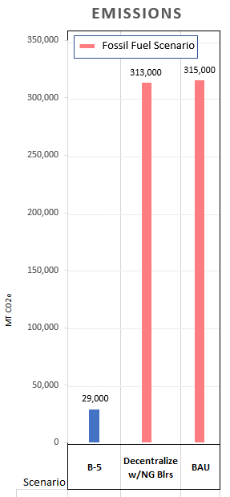
Notes:
Illustrates the effective emissions from each option.
Assuming 4.6 metric tons COT/passenger car/year. 92 Metric tons over 20 years.
313,000 MT – 29,000 MT – 284,000MT
/92
Similar to removing 3k passenger vehicles from the roads for 20 years or the impact of a 1,000 Americans for 20 years (14.4 metric tons/year)

Slide 6
AACE cost estimate classification level 4 and is within ±30%
Design for this size and complexity project will likely fall between 6.5% to 7% (roughly $13M-$14M for B5)
Notes:
Showcases the capital costs. Note E1 is by far the lowest capital cost and therefore lowest hurdle, and it also has the lowest LCOE and is by far the simplest project. Its main drawback is emissions. B5 while having the lowest LCOE has the highest capital expense, highest risk (as it requires recruiting more customers and significant project complexity and development).

Slide 7
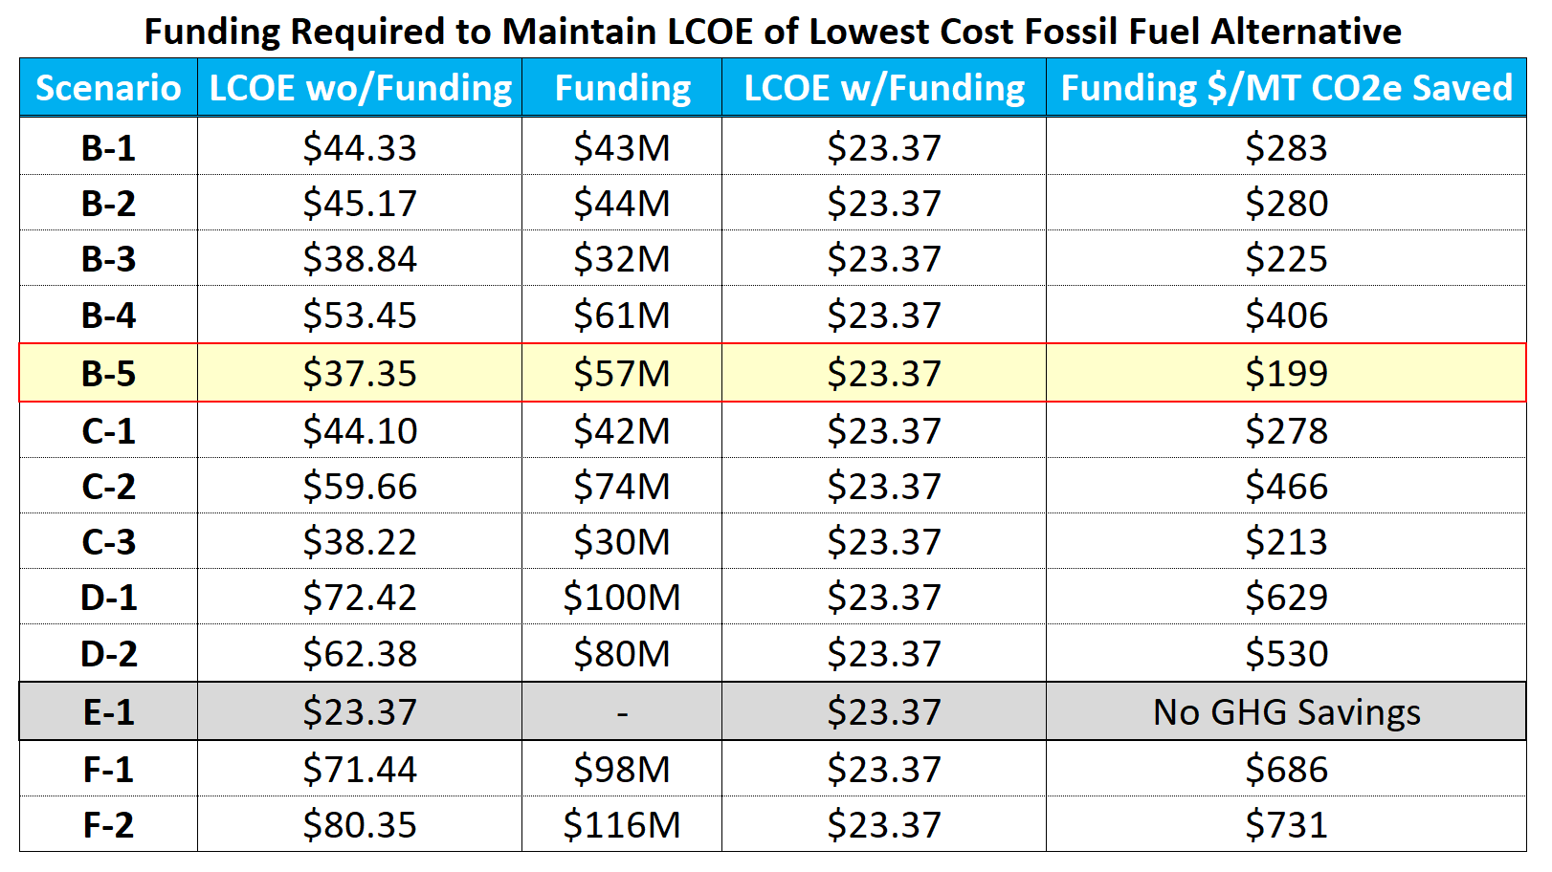
Notes:
Illustrates the minimum amount of funding that would be required to compete with the distributed natural gas boilers and how cost effective the solution is on a funding $ per CO2 saved

Slide 8
Key Takeaways from the Clean Energy Master Planning Process
Electrical Demand Impact
Scenarios with decentralized heat pumps installed locally at each building as in Scenarios D and F will require electrical distribution system upgrades.
Decentralizing with heat pumps sized to meet 100% peak load (Scenario F-2) has the largest electrical needs and is expected to exceed the current 100MW interconnection limit.
Natural Gas Peaking Benefits
Flexibility
Redundancy for emergency
Building Improvements
Address direct steam uses by hot water conversion or point-of-use steam generation
Infrastructure Scenarios
Emission Reduction
Relatively higher added CAPEX to completely eliminate carbon emissions reduction via electrification of peak load
Peak load electrification more expensive per unit of carbon reduction
Bridging fuel -while utility infrastructure catches up
Manages capital spend
Future renewable fuel currently under development for transportation industries
Reuse of existing infrastructure and backup power assets
Retrofit or replace HVAC systems in buildings with high (>180°F) hot water supply temperature requirements
Lower supply water temperatures improve heat pump performance, but early HVAC replacement may not be cost effective
Renovation approval and timing
Hazardous materials may increase project costs
Piping material decisions: temperature and pressure
Centralized solution is preferred over decentralized
Land area needs for geothermal
85% reduction is achievable without 100% electrification

Slide 9
Ramboll Recommended Next Steps
Heat Mapping – Assess buildings that should be connected to the district heating network initially and identify buildings and areas which have the potential to be connected in the future.
Building Assessment – Evaluate, investigate, and perform testing of the heating system within each of the currently connected buildings as well as buildings identified during heat mapping for connection. Evaluation, investigation and testing are defined in Section 5.3 of the report. The investigative work in current and potential buildings will also determine if additional heat sources are available to feed into the district heating network such as cooling loads that can easily be served with heat recovery chillers.
UPMC Hospital Steam Conversion – Develop a strategy to convert the Hospital from steam to hot-water and to meter, for greater accuracy, heat rejected from its year-round cooling load.
Pipe Replacement Phasing Strategy – Develop a strategy to replace approximately 70,000 LF of pipe in a phased approach that addresses age, condition, and capacity in relation to the project’s needs. In addition, the strategy will define all phasing requirements such as temporary heating units, structures, and investment needs by year.
Customer Education Campaign – Teach the community about the project, opportunities, and to help identify potential take rates and interest of new and existing customers should the new system be constructed. Educate customers on cost effective energy efficiency measures that can typically be performed at buildings to reduce overall energy consumption.
Geothermal Testing – Since the geothermal bore field size, depths and cost in this report are based on conservative industry standards, subsurface testing as well as evaluation of various bore field heat exchangers should be provided. Test results could identify much higher heat extraction rates with shallower drill depths.
Monitor Market Development – Monitor advances in heat pump technology and US market availability.

Slide 10
Funding Resouces
Clean Energy and power $74,952,140,781

Slide 11
Clean Energy and Power
Funding Resources by Bureau

Slide 12
Breakout of programs
Notes:
Energy Efficiency and Renewable Energy Office of Clean Energy Demonstrations
Note: NYSERDA FLEXTECH program may be an avenue to do studies for industrial companies to evaluate electrification of their heating systems, one option to which could be the district connection. Funding currently available through federal grant to NYSERDA. Also, limited funding available for non-SBC higher ed. Still need solutions for commercial/residential/hospital. 75% of study could be covered by programs.

Slide 13
Draft Initial BPU Staff Recommendation for Next Steps
Try to secure design funding for B-5 (~15 Million)
Try to secure fund commitments to ensure get LCOE comparable to natural gas
Increase rates starting heating season of 2024-2025 ($6-$9/MMBTU)
Communicate failure to receive funding commitments will result in system shutdown around 2027-2030
Educate community on the benefits of district heat and the proposal
Meet with industrial customers in the primary corridor and gauge interest
2024

Slide 14
If Funding Commitments are Secured
2025
Hire engineering firm and begin technical design
Begin customer side BHW testing and thermal envelope evaluations
Begin execution of MOUs with new customers for service
Begin replacing critical existing pipe and backup loops to maintain reliability
Raise rates $9-12 (2025-2026 Heating Season)
2026
Finalize design, confirm funding and LCOE objectives are met, create phasing plan, create bid packages for materials and construction of new assets. Bonding.
Issue bids for construction
2027
Begin construction from wastewater and pick up new customers along the route
Raise rates $16-19 (2027-2028 Heating Season)
2028
Begin phase in/back feed of existing system and replacement of original pipe
Raise rates $20-$24 (2028-2029 Heating Season)
2031
Complete project
Raise rates $12-15 (2026-2027 Heating Season)

Slide 15

If Funding is Not Secured
2025
Raise rates $12-14 (2025-2026 Heating Season)
Communicate with customers shutdown plan
2027-2030
Shutdown system 2027-2030
Pay off bonds
Remove above ground infrastructure, abandoned underground infrastructure
Consider flow fill of pipe network if funds allow

