Slide 1

Jamestown’s
District Heating
System
Mission of the BPU
Provide environmentally sound, efficient, cost effective electric, water, solid waste, wastewater, and district heating utility services while actively encouraging the economic growth and development of its community.

Slide 2
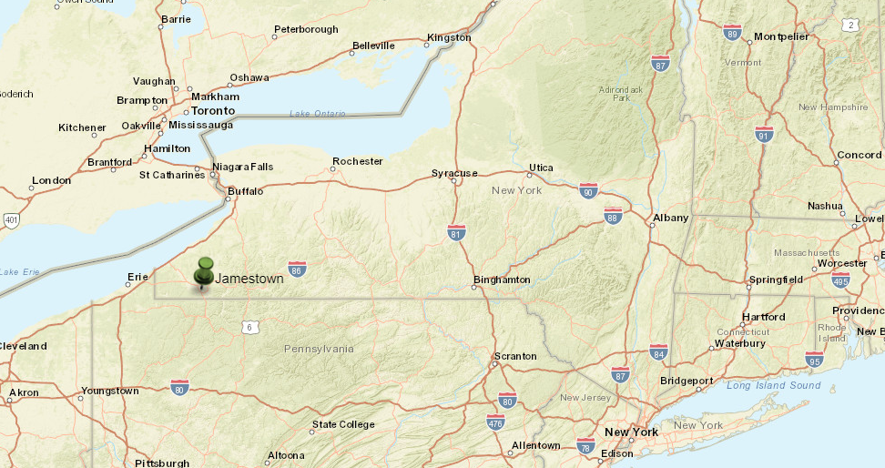

Slide 3
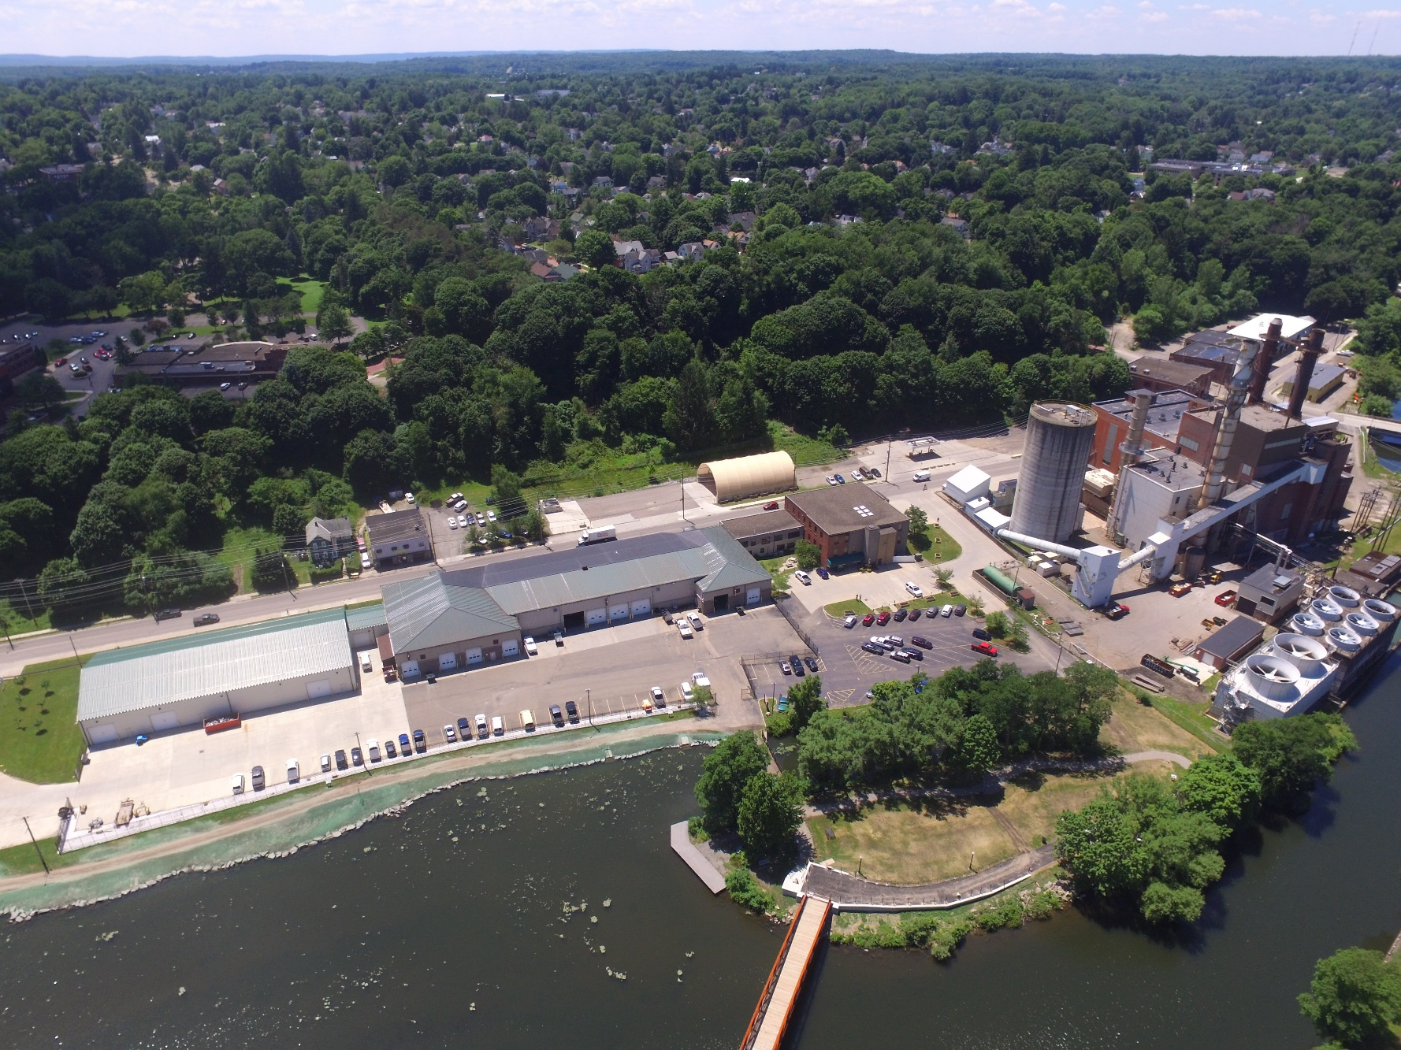
Jamestown Board of Public Utilities
Jamestown has been generating power since the 1891
Incorporated in 1923 as a Non-Profit Municipal Entity
- One of 51 electric municipals in NY
  3rd largest but small compared to the large private utilities
  1 of only 3 with electric generation capability
- 5 Separate Divisions
  Electric - $44Mil
  Water - $5.6Mil
  Waste Water - $5.3Mil
  Solid Waste - $2.7Mil
  District Heat - $1.3Mil
150 Employees
Notes:
Full study reports are available here:
Ramboll Study Results (Password required until public release, reach out for access)

Slide 4
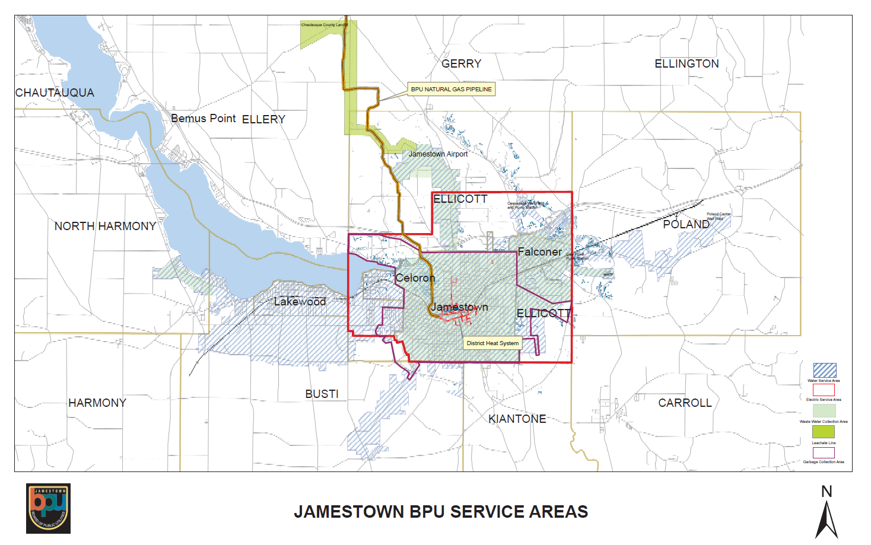

Slide 5
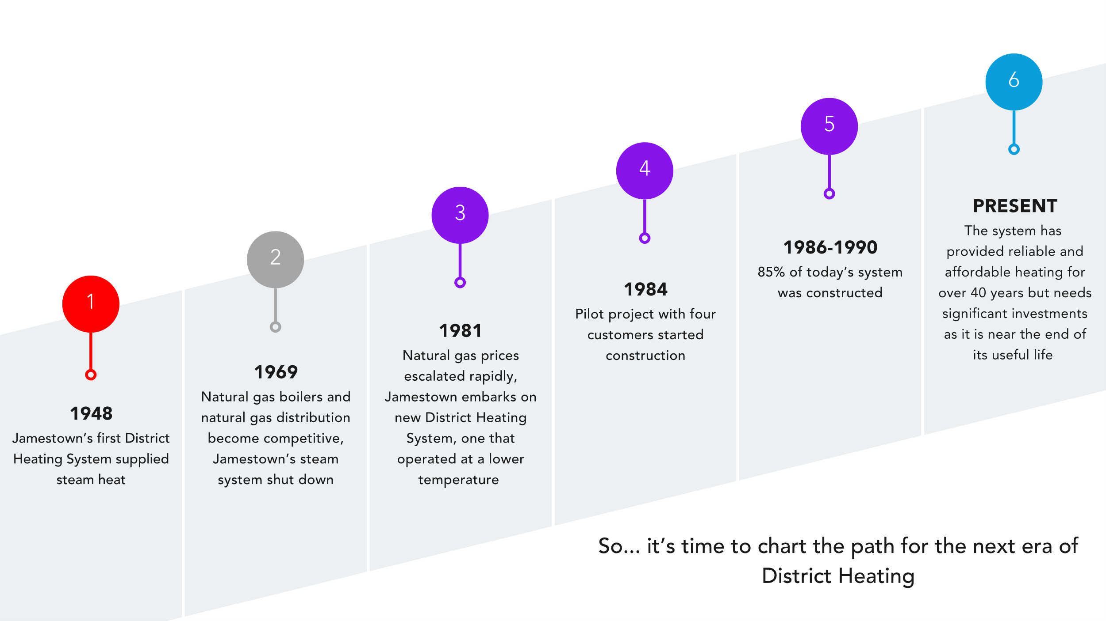
Jamestown’s District
Heating Journey

Slide 6
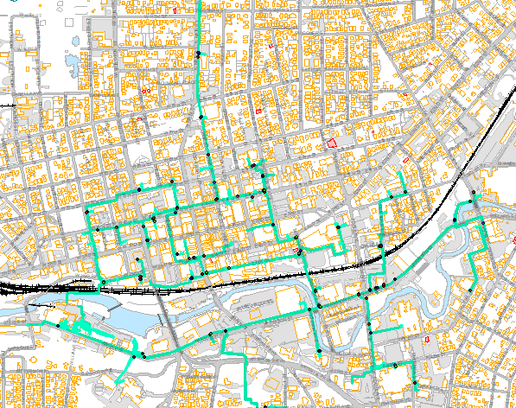
Who has District Heating today?
70 Customer Facilities
Over 700 apartments
Primarily disadvantaged community census tracts
Serves not-for-profit organizations, churches, public school buildings, regional hospital, small businesses

Slide 7
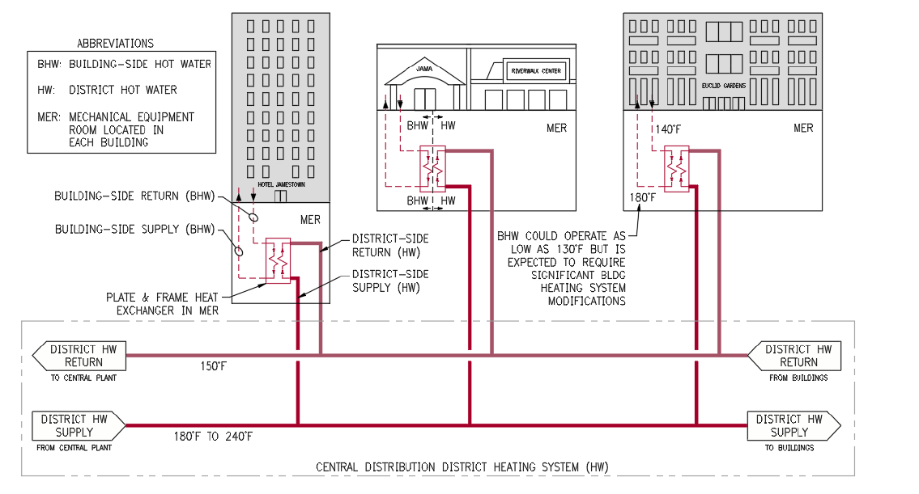
Distribution General Operation
Annually the system consumes about 170,000 MMBTU (~50,000MWh)
Peak in the winter heating season is around 31,000 MMBtu/Month (~9,085 MWh/Month) an average hourly rate of 36 Dekatherms/hr (~10MWh)

Slide 8
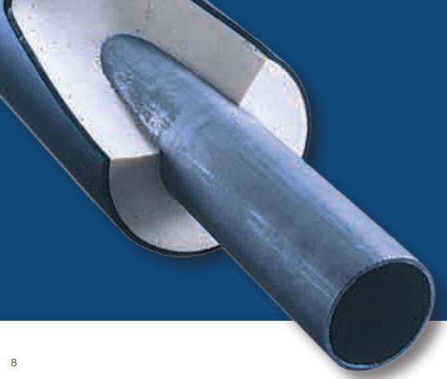
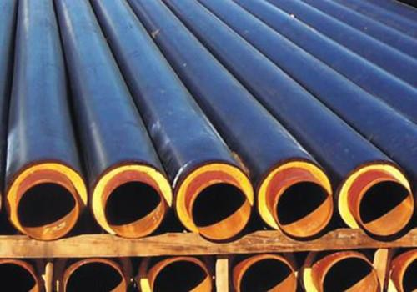
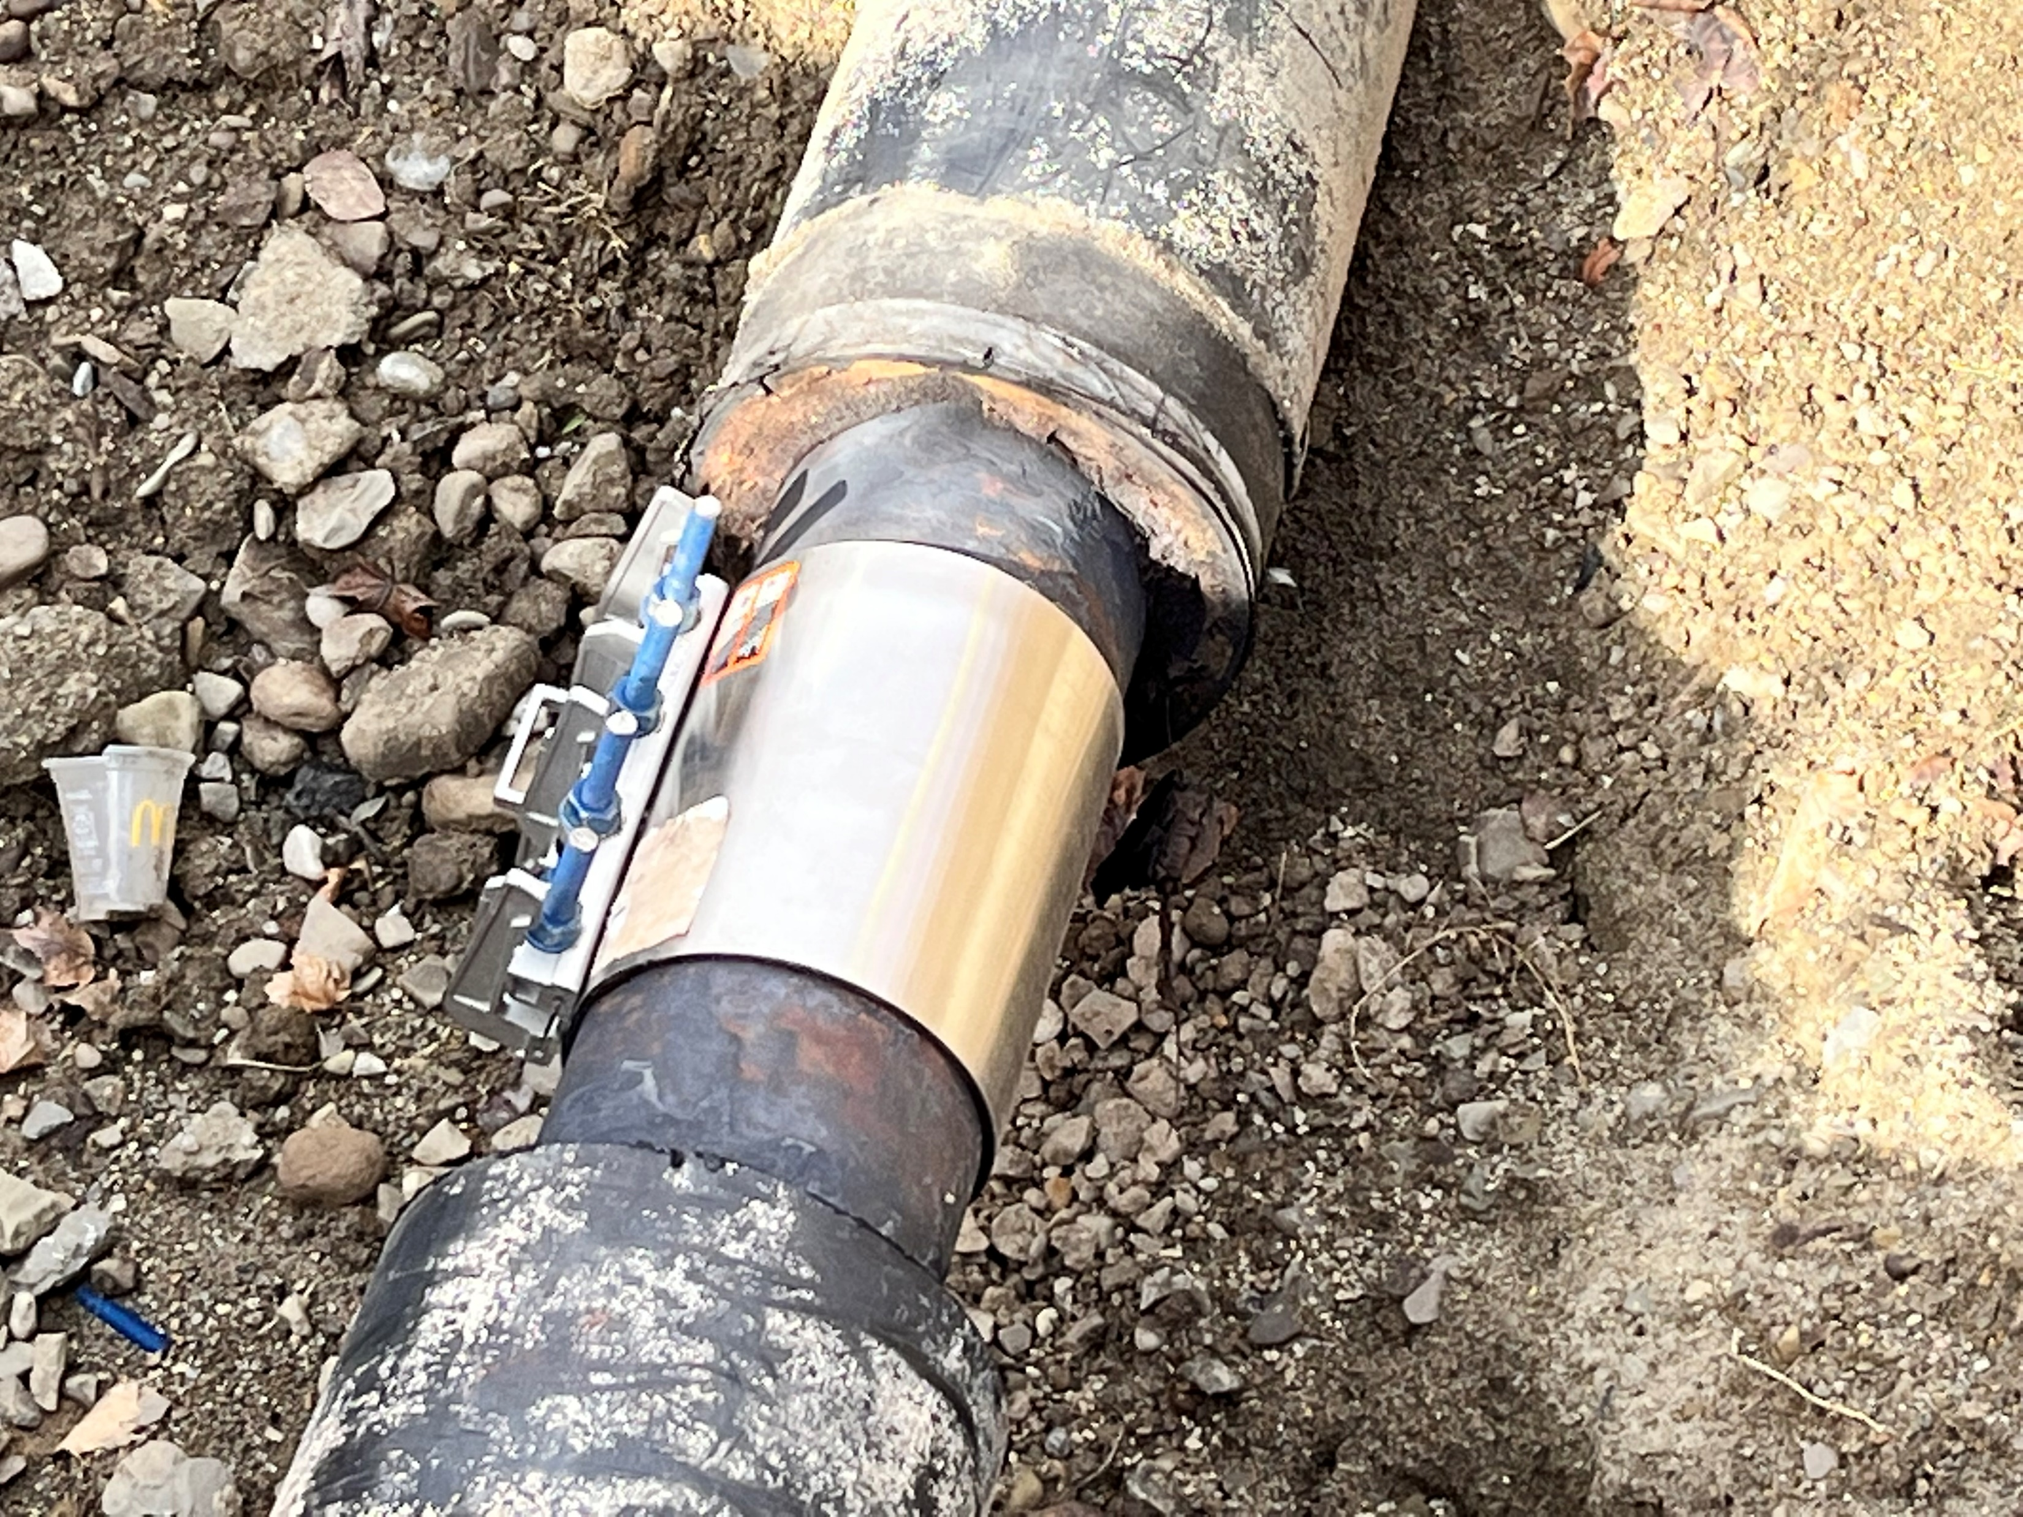
Current Distribution Pipe – EN 253

Slide 9
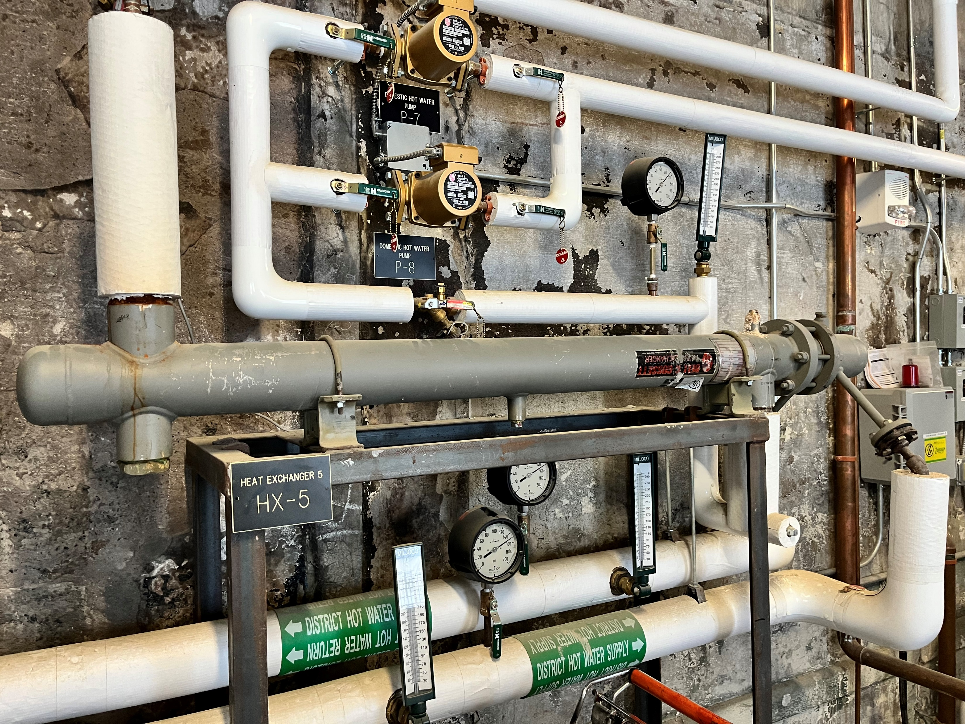
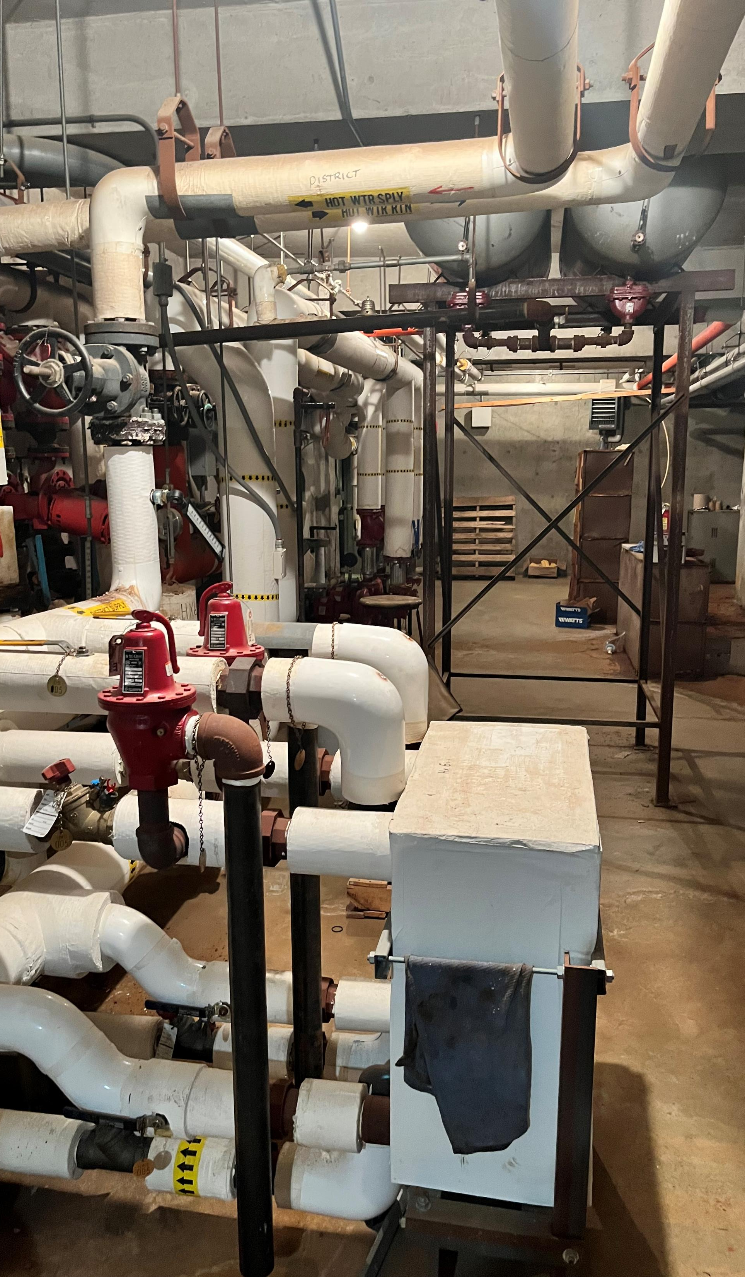
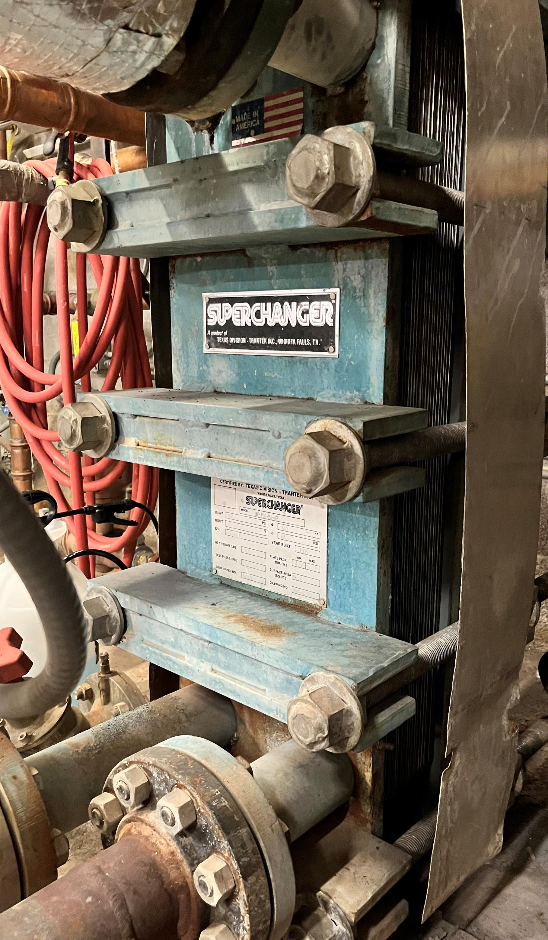
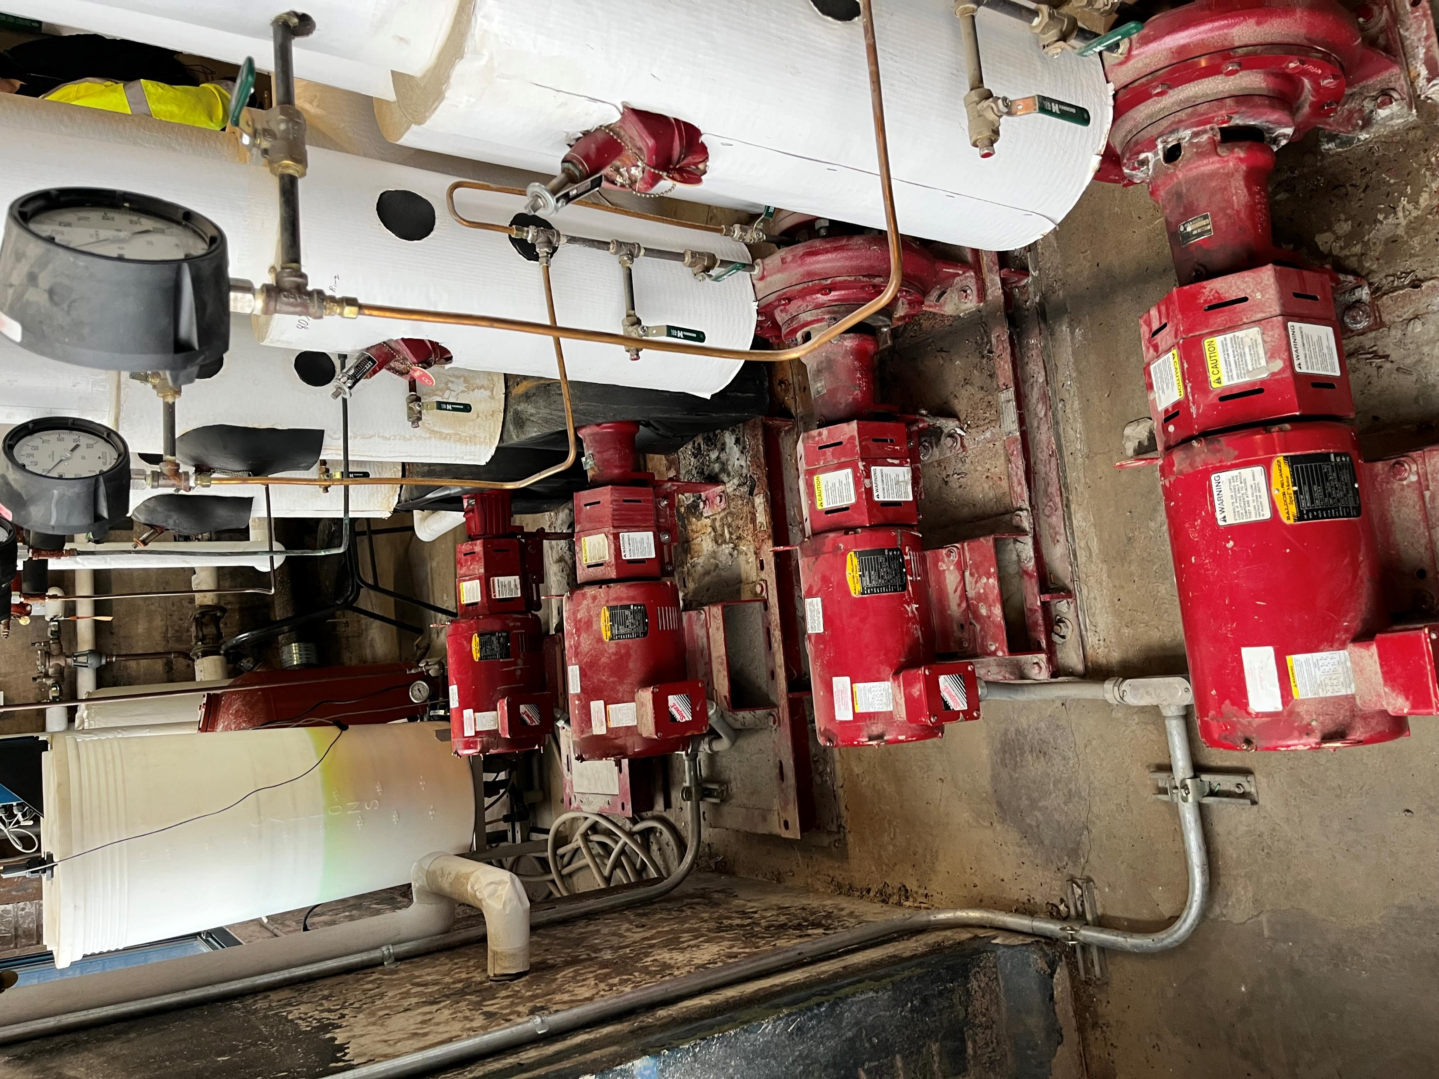

Slide 10
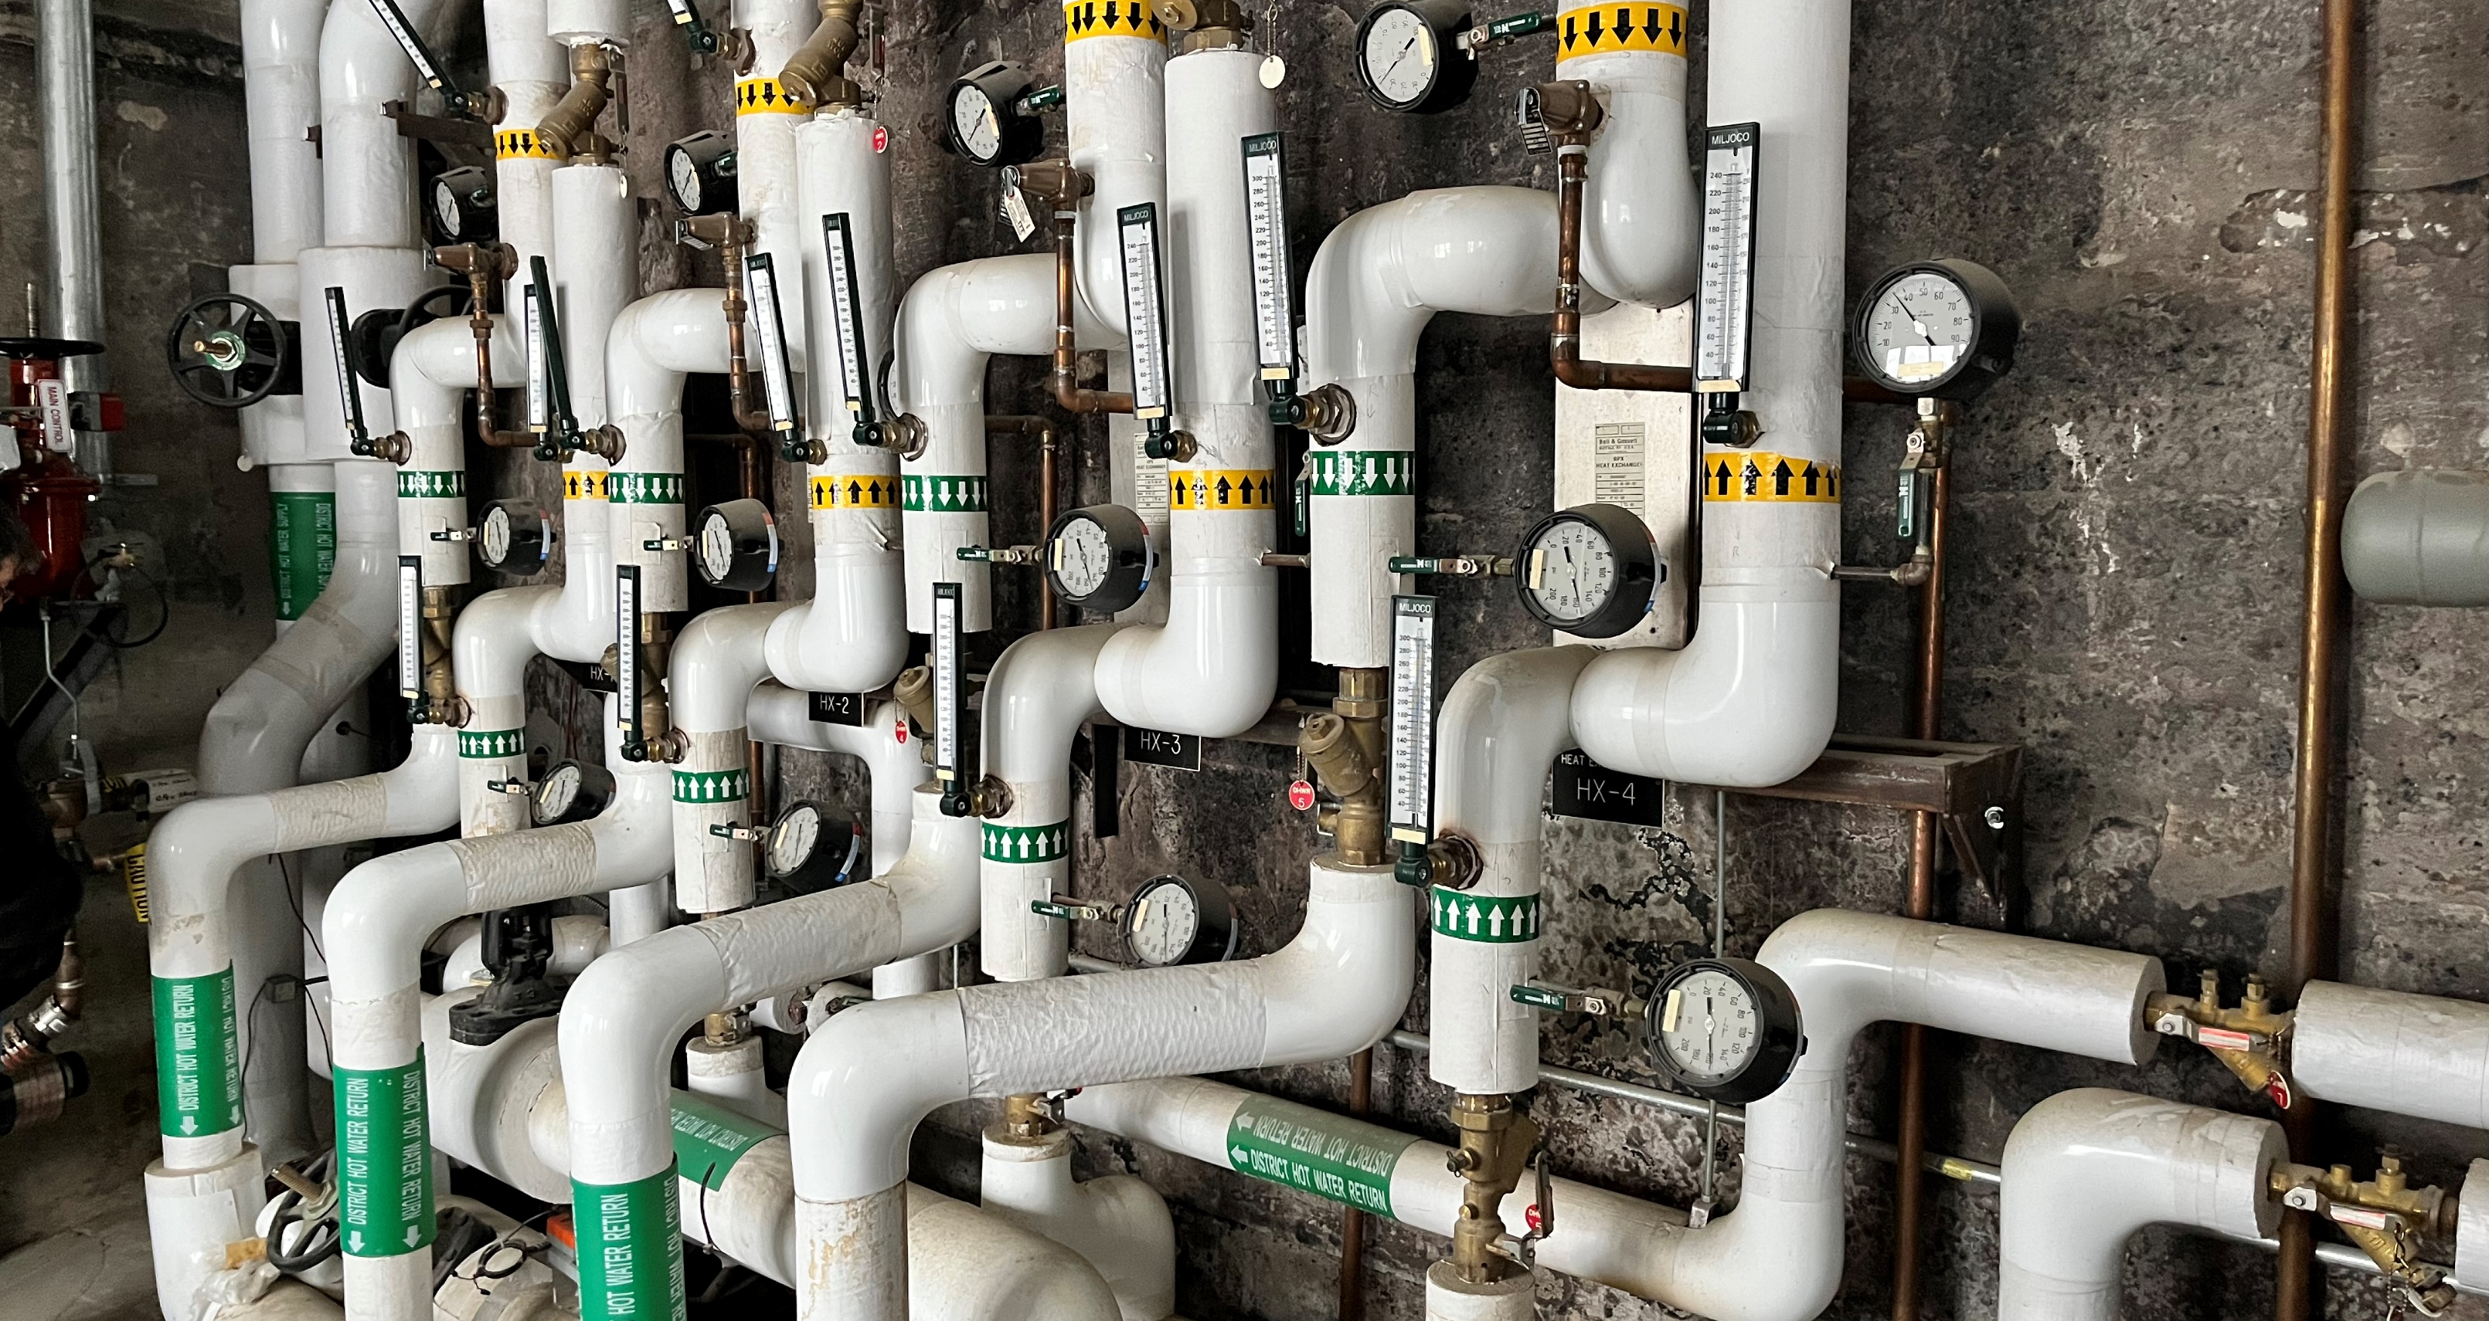
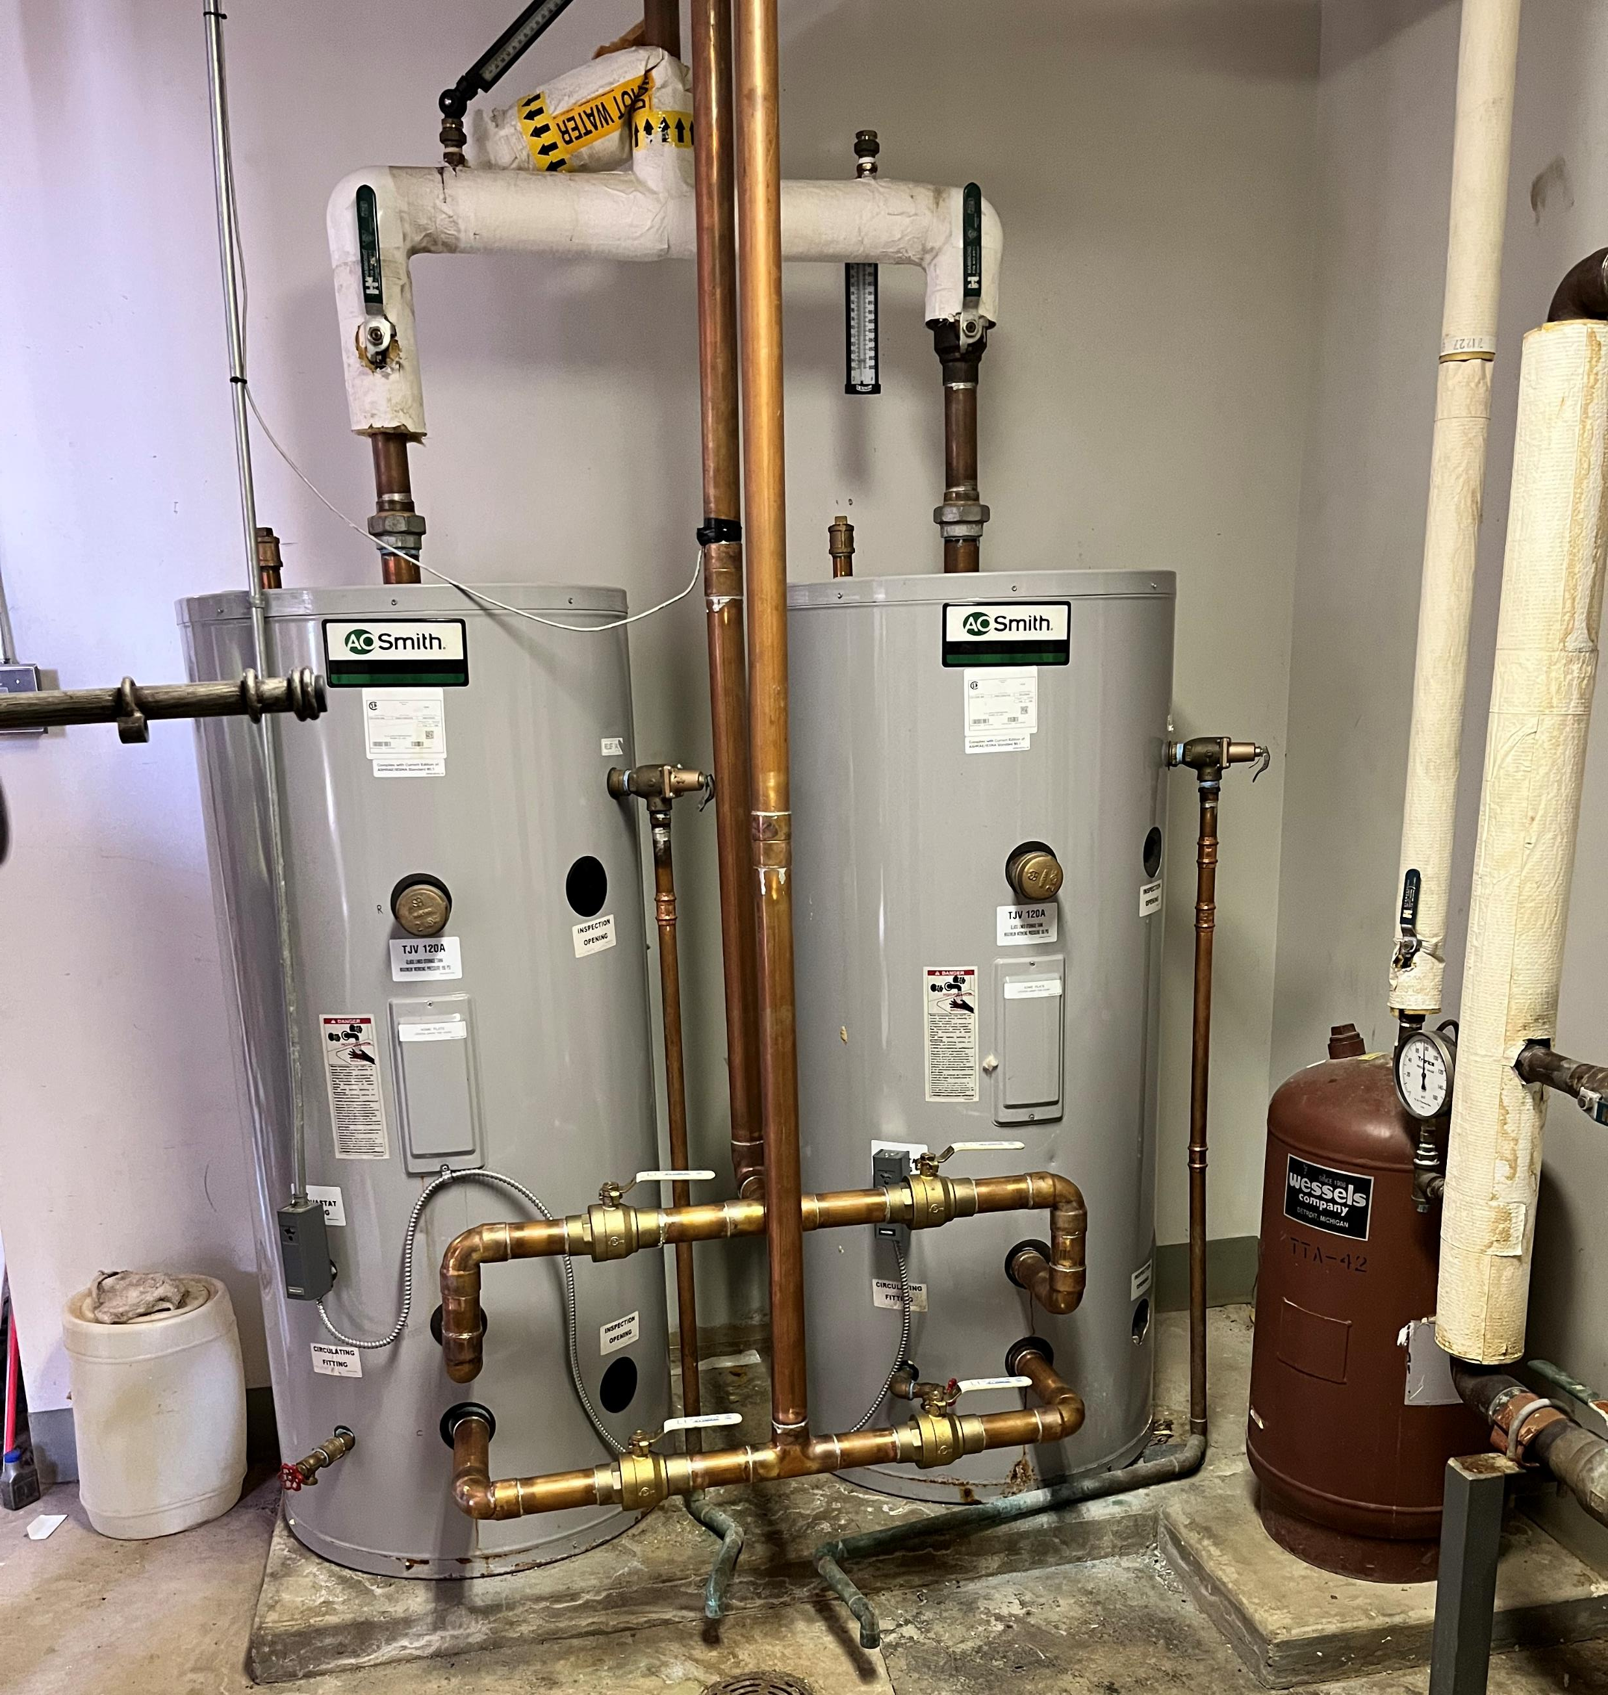
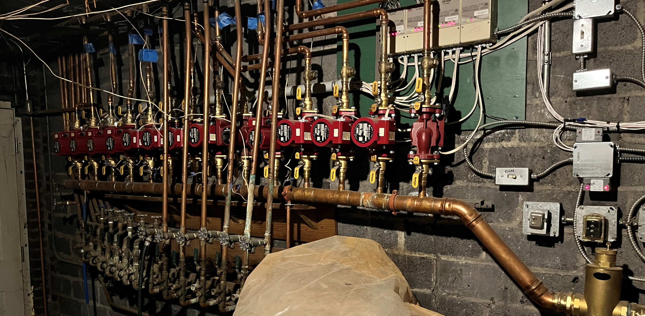

Slide 11
What is District Heating?
Thermal Supply Operations

Slide 12
Why Change?
Existing infrastructure is near end of life.
State and federal direction toward economy-wide decarbonization.
Economics of current system using natural gas are at risk.
Lack of unified action may result in the most expensive community outcome (direct electrification).
Local emissions impact community health; improving local health has personal, social and economic benefits.
Industry now needs to stay competitive economically and environmentally. Falling behind could mean loss of local industry and jobs.

Slide 13


Slide 14
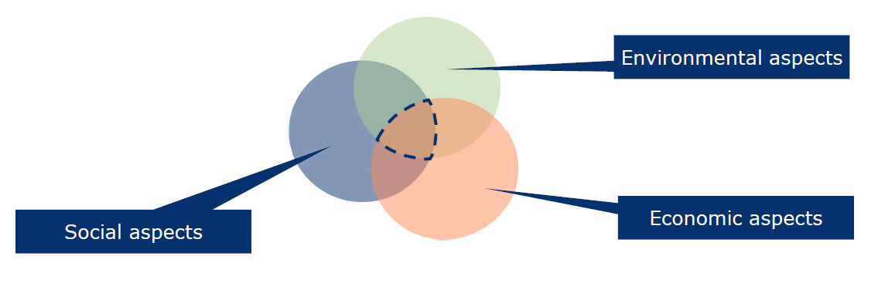
So, what are the options?
A year and a half engineering study by Ramboll with support from NYSERDA reviewed 30 technologies ranked on CAPEX, OPEX, CO2 Neutrality, System Integration, Quality, and availability
5 Fossil Technologies (Natural gas boiler, hydrogen, solid state oxy, oil, turbines/engines)
16 Renewable Technologies (Biofuel, Biomass (various), hydrogen (various), electric (various), solar thermal, etc. )
9 Electrification technologies (Electric Boiler, Heat Pumps (air, air to water, etc.), ground source heat, recovery chillers, water-water (sewage)

Slide 15
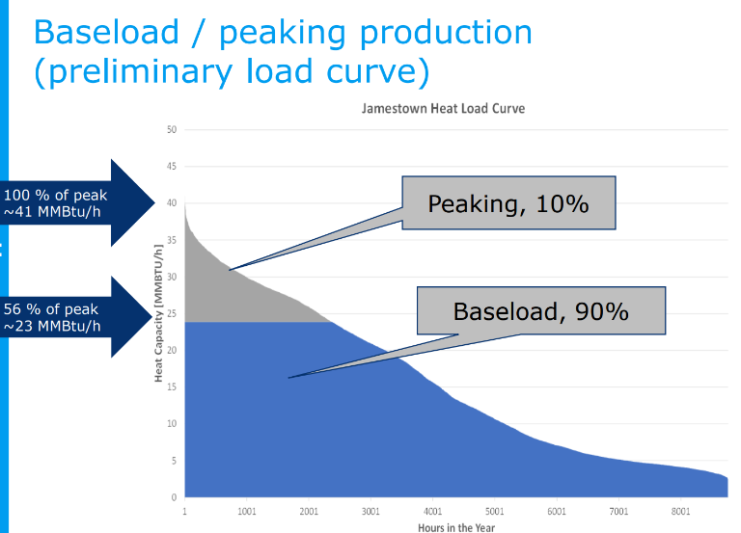
Baseload / peaking characteristics
  Often high capital expense (CapEx)
  Should be in operation many hours per year
  Should have low energy cost
Peaking / backup technologies characteristics
  Often low CapEx (e.g., boiler technology)
  High fuel costs (so low operation hours)
  Very high technology reliability (backup)
  High fuel supply reliability
Notes:
Splitting the source into base load vs peaking is more cost effective than choosing one resource alone. A baseload resources has high capital cost per output but if run a lot, the effective cost per unit of energy goes down. Increasing these resources to meet full system capacity is capitally expensive and raises the effective price as the total capital cost is higher but the run time didn’t increase much. The peaking technologically may be cheap from an installed capacity perspective but it’s fuel source could be expensive in price. The trade off is O&M verses capital cost, a combination of both types of resources maximizes each resources value to the system and results in lower overall costs.

Slide 16
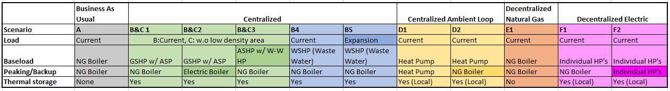
Options that warranted a deeper dive
The study shows that the use of clean, warm water from the BPU’s wastewater treatment plant effluent (B5) is the lowest-cost decarbonization option.
The wastewater option includes a potential significant expansion to add the community college, industrial corridor and additional schools.

Slide 17
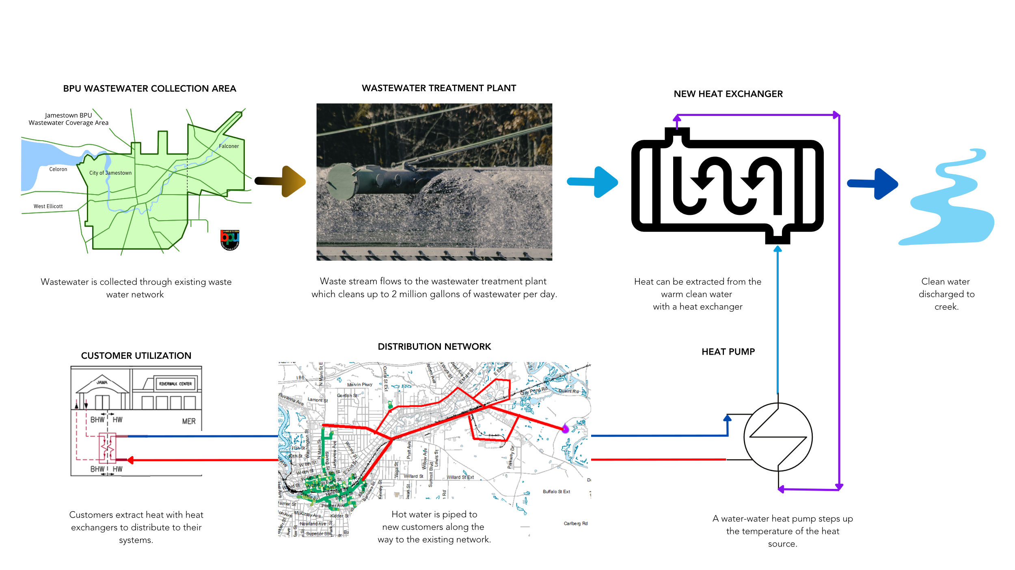
How will it work?
(Check out the wastewater plant tour to learn more.)

Slide 18
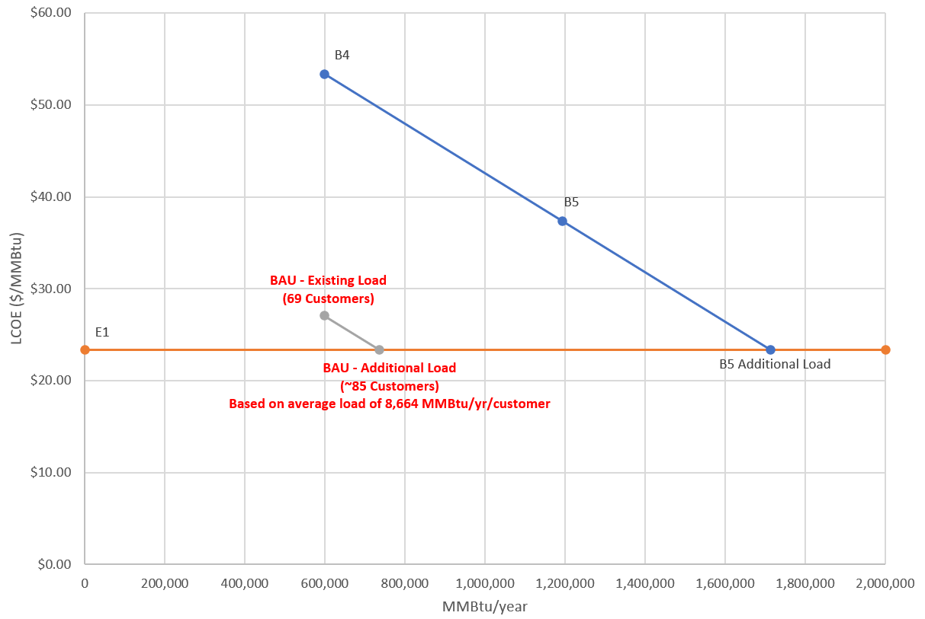
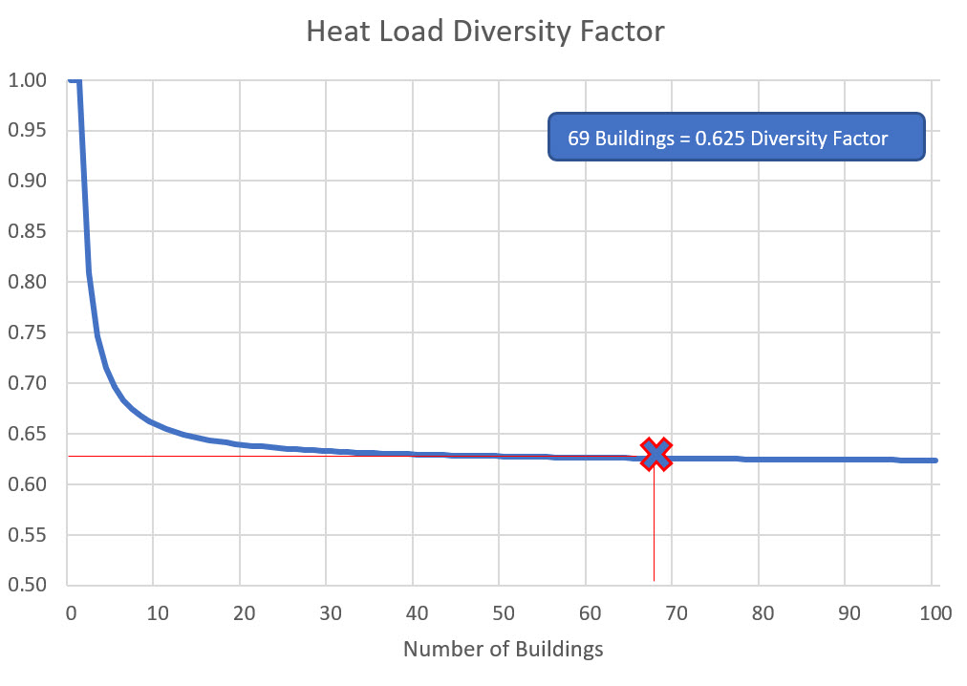
Why do more customers lower cost for everyone?
Additionally, due to load diversification the total installed capacity can be 37% less than if everyone installed their own equipment.
The primary challenge with this system is the upfront capital cost but the more customers the BPU can get on the system, the more that upfront capital cost can be spread out and the lower the unit cost for everyone.
There is also potential for thermal energy storage which is far cheaper per unit of energy than electric storage options
Notes:
The more load (with out adding more infrastructure) the lower the per unit energy cost! Community wide engagement and a high take rate would drive down LCOE even further!

Slide 19
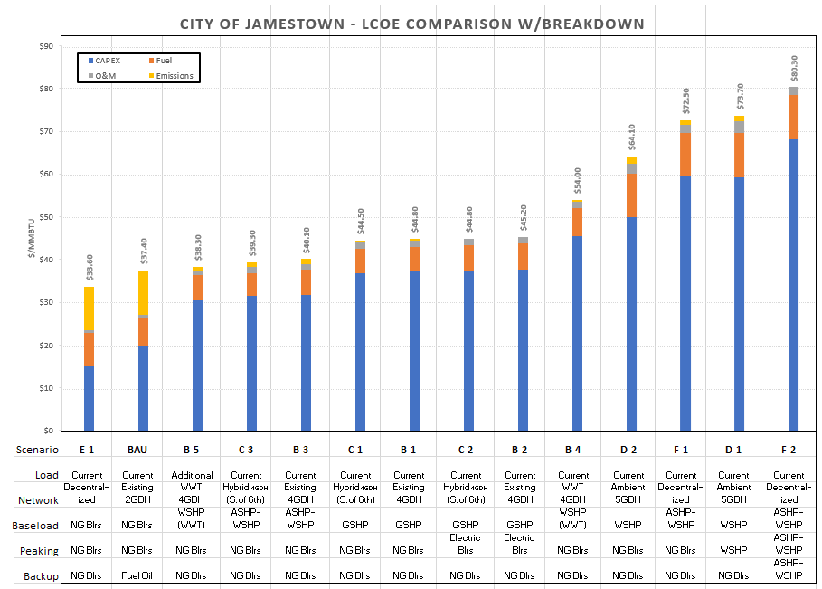
What will it cost?
Lowest Cost Decarbonization Solution
~1.6x today’s rate w/o emissions. ~13% more than natural gas if emissions are included
100% Direct electrification is at least 3x today’s rates
The levelized cost of energy (LCOE) is a comprehensive way of evaluating total energy costs. It is presented as a dollar cost per unit of heat delivered ($/MMBTU). This cost includes capital costs (CAPEX), fuel costs, operation and maintenance costs (O&M), and emissions costs (per NYS Cap and Invest targets). This enables comparison of various technologies that have very different cost structures over a 20-year period.
Natural Gas w/ Emission Costs
Notes:
Shows the effective, “all in” energy price for each system with projected emissions costs per NYDEC. Not this does not include staffing

Slide 20
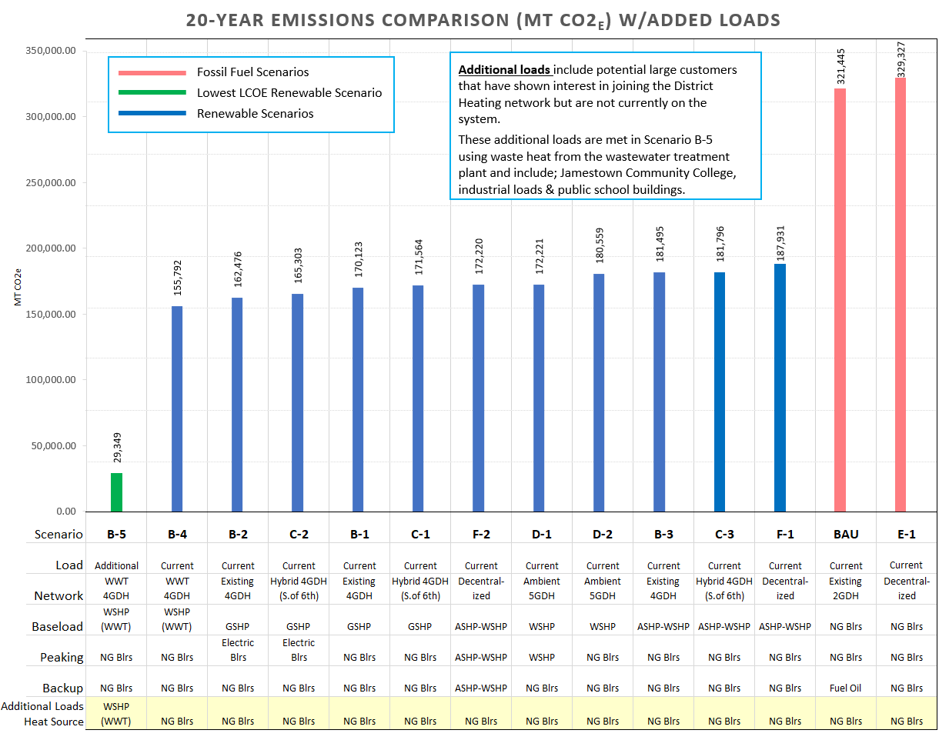
Lowest Cost Decarbonization
Solution -
the biggest green house gas reduction due to increased service area
Notes:
Illustrates the effective emissions from each option.
Assuming 4.6 metric tons COT/passenger car/year. 92 Metric tons over 20 years.
313,000 MT – 29,000 MT – 284,000MT
/92
Similar to removing 3k passenger vehicles from the roads for 20 years or the impact of a 1,000 Americans for 20 years (14.4 metric tons/year)

Slide 21
Decentralized Natural Gas
Today’s system if we kept the same and replaced pipe
Decentralized Air Source Heat Pumps (not including transmission or capacity needs)
Lowest Levelized Cost Decarbonization Solution
Has the highest capital cost…
Notes:
Showcases the capital costs. Note E1 is by far the lowest capital cost and therefore lowest hurdle, and it also has the lowest LCOE and is by far the simplest project. Its main drawback is emissions. B5 while having the lowest LCOE has the highest capital expense, highest risk (as it requires recruiting more customers and significant project complexity and development).

Slide 22
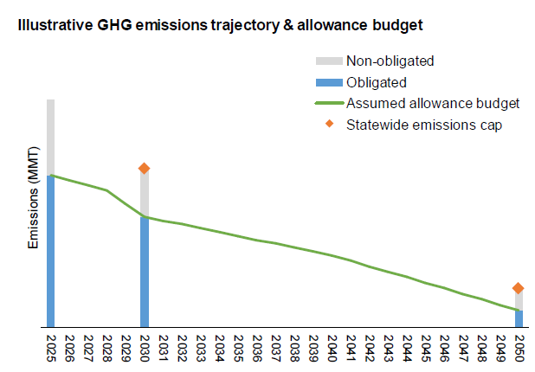
What if we wait?
Community members will each make their own decisions, and the lack of coordination now will make it difficult or impossible to come back and create a better system.
Rising costs may not be realized until it’s too late to facilitate a central system. Community action and coordination now is required to facilitate the lowest cost option.
Federal and state funding for this initiative will likely not be around long-term.
Cost of emissions

Slide 23
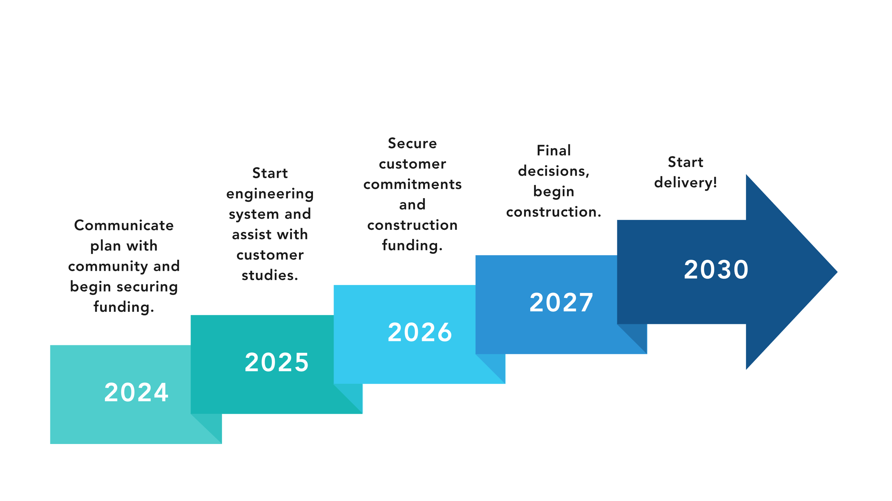
What is the future timeline?
Notes:
The more load (with out adding more infrastructure) the lower the per unit energy cost! Community wide engagement and a high take rate would drive down LCOE even further!

Slide 24


